Slide 1
Presentation for linguistic practice
Prepared by Pereverzev An. , Pereverzev Al. , Tretyak D. , Goryaniy A.

Slide 2
May the language be with you!
Language House

Slide 3
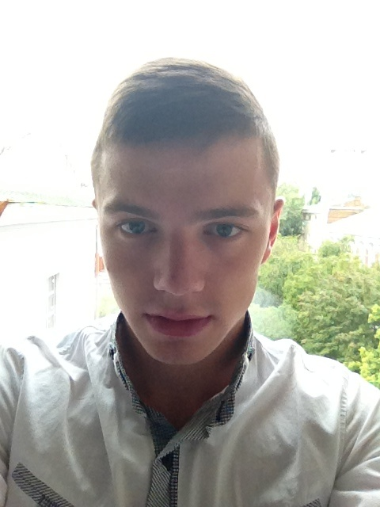
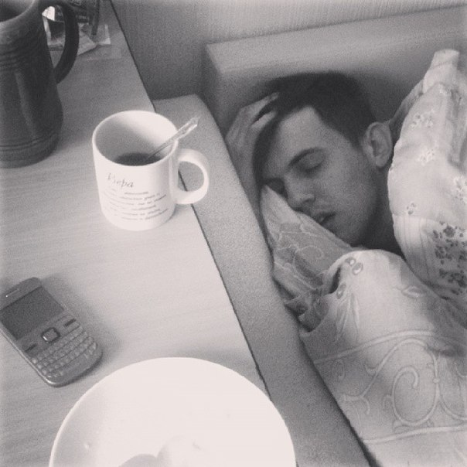
CEO
Andrew Pereverzev
A secretary, HR
Dmitriy Tretyak

Slide 4
A marketing manager
Aleksandr Pereverzev
A financial manager
Aleksandr Goryaniy

Slide 5
Personnel
CEO, a secretary, financial and marketing managers. Six full-time learning staff, two administrators, two cleaners for one office (3 offices).
Service
English language training individually or in groups. Various meetings with native speakers and foreigners being improved for your language.

Slide 6
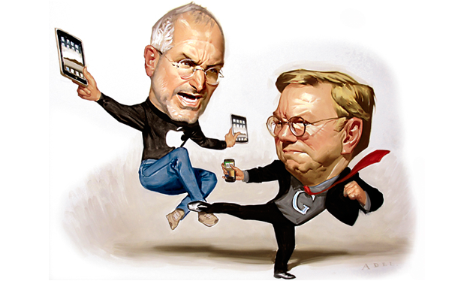
Market
Competitors
Audience

Slide 7
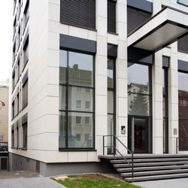
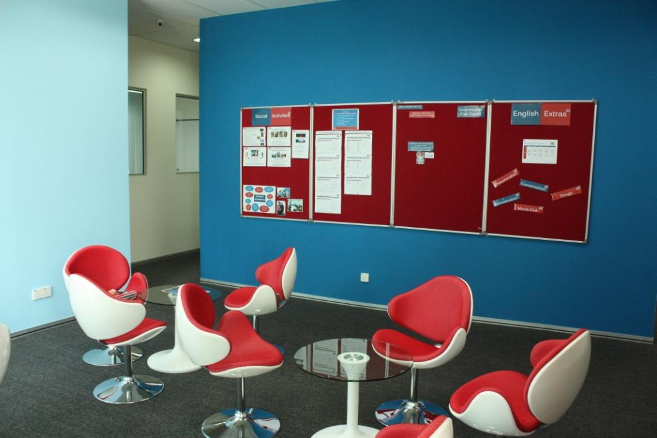
Premises/machinery

Slide 8
Thanks for your patience
Any questions?

